Slide 1

Big data platform (Spark) performance acceleration
Mentors: Tony Tan, Ning Wu, Yong Wang and Theo Gkountouvas
By:
Grishma Atul Thakkar
Virat Goradia
Nipun Midha
Baoshu Brady Qi

Slide 2

Sprint Goals
Further understand existing spark internal code
Design strategies to implement N-Way merge algorithm
Start implementing the N-Way merge algorithm.

Slide 3
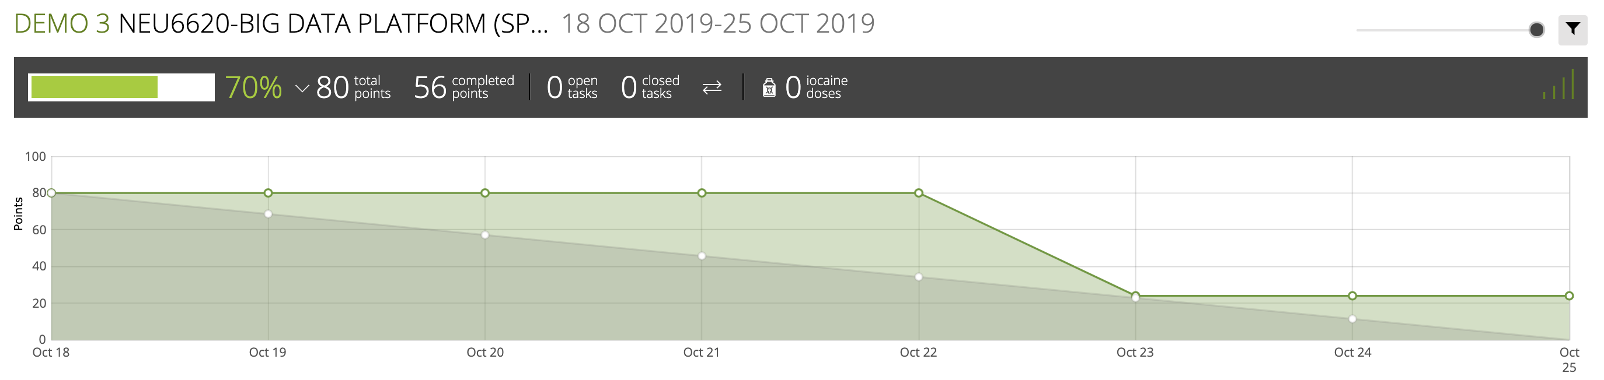
Burndown Chart
Notes:
This is our burndown chart, we assigned 80 points out of which we were able to achieve 56.
We were stuck because of challenges we were facing with spark internal working which we were able to figure out at the end.
We have almost figured out what all classes and methods we will use next we will be working on figuring out how to incorporate the riffle suggestions

Slide 4

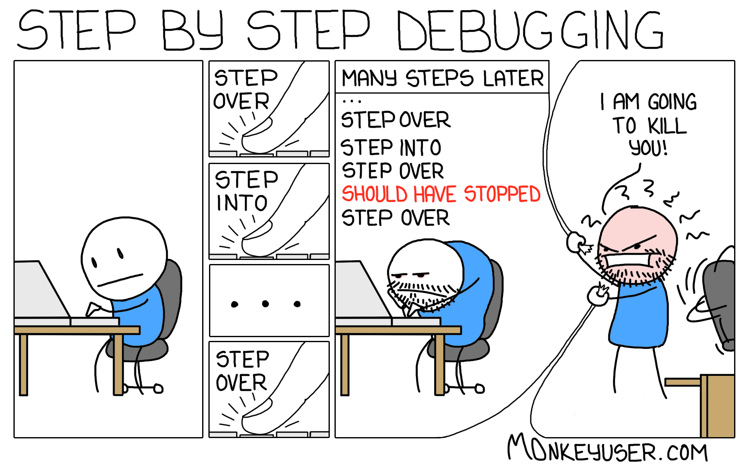
Spark Codebase
839,842 lines of code

Slide 5



Challenges
Notes:
Paper presentation
Spark code
Spark debugging setup
Abstraction in spark

Slide 6
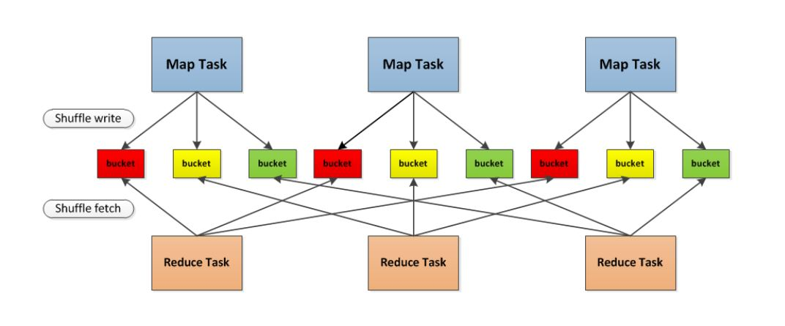
Spark's Shuffle Phase
Notes:
First, each Mapper will create a corresponding bucket according to the number of Reducers. The number of buckets is M x R , where M is the number of Maps, and R is the number of Reduces.
The bucket here is an abstract concept. In the implementation, each bucket can correspond to a file, which can correspond to a part of the file or other.
Secondly, the results generated by Mapper will be populated into each bucket according to the set partition algorithm. The partition algorithm here can be customized.
When the Reducer starts, it will process the corresponding bucket as the input of the Reducer from the remote or local block manager according to the id of the task and the id of the Mapper.

Slide 7
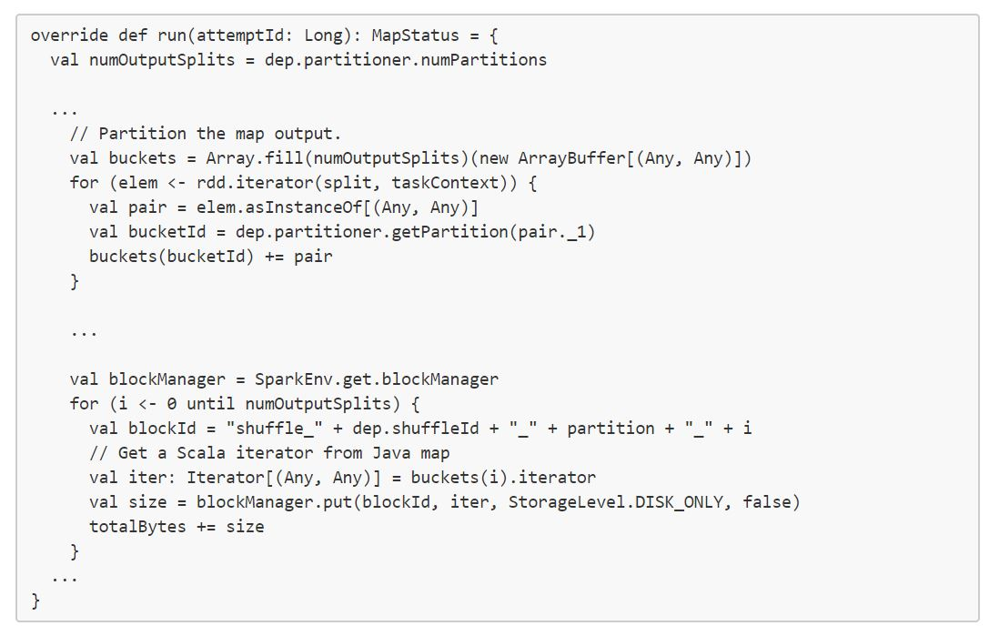
ShuffleWrite - Older Version
Notes:
ShuffleWriter is used for writing map output
You can see that Spark creates a bucket for each Reducer in each Mapper and puts the RDD calculations into the bucket. It should be noted that each bucket is an ArrayBuffer , which means that the output of the Map will be stored in memory first.

Slide 8
Problems with it
1. Spark will first save all the data in memory and then dump it into disk
2. Each mapper will generate a small file for each reducer. I/O will be significantly slowed when transfer large amount of small pieces of files.
Notes:
This is a very large overhead for memory, and OOM occurs when there is not enough memory to store all the Map output.
If the number of Mapper is 1k and the number of Reducers is 1k, then 1M shuffle files will be generated, which is a very big burden for the file system. At the same time, in the case that the amount of shuffle data is small and the shuffle file is very large, random writing will seriously degrade the performance of IO.

Slide 9
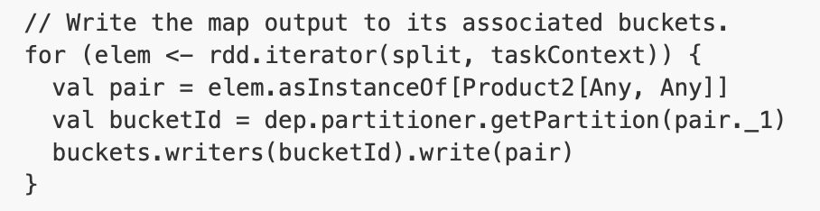
ShuffleBlockManager
Spark then introduces ShuffleBlockManager, which assigns a DiskObjectWriter to each bucket, to manage the shuffling files .
Notes:
In order to overcome the first problem, spark then introduces ShuffleBlockManager, which manager all shuffle files, to control the data transfer between map phase and reduce phase. It implements a DiskObjectWriter, which, instead of creating large overhead memory, it writes the data directly into files record by record.
The last line of this piece of code explains everything. Instead of re-creating a iterator, it directly write the pair to corresponding bucket.

Slide 10
Problems still exist
Problem with large amount of small files still exists.
Number of fix-sized writer buffer depends on the number of reducers. For a 8 core machine, 1k reducer requires 800 MB memory.
Notes:
Still this implement doesn't solve the small tmp file problems. Besides, as we mentioned before, each bucket has a writer, which has 100 kb buffer, and the bucket corresponds to a reducer. If we create like 1k reducer, each map will have 100 bucket and will have to create 1k writer. That 100 mb memory usage for each mapper.

Slide 11
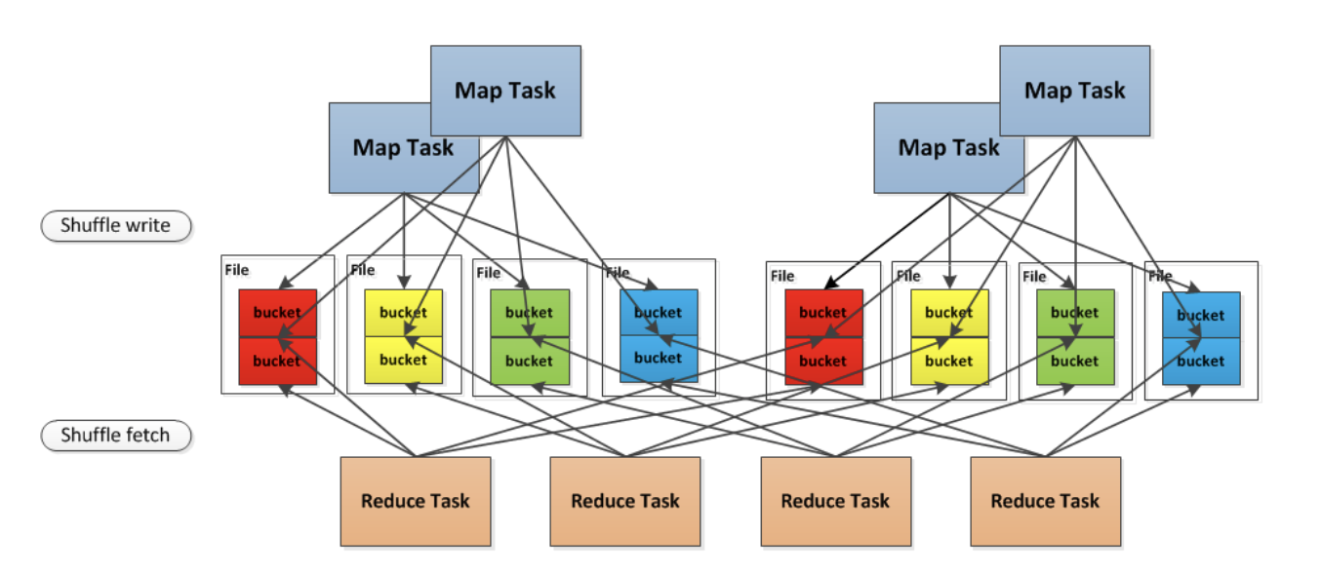
Shuffle consolidation
Notes:
In order to solve this problem, spark introduces a concept of consolidation, instead of create separate bucket for each reducer in each machine, now the bucket is corresponding to a segment of file, which significantly reduces the amount of file transfer during the shuffle phase.
The second problem is more difficult, imagine two different function, reduce by key and group by key, spark implements an in-map combiner, which reduce the amount of write action. But group by key requires mapper send everything to reducer, which sometimes will cause oom issue. We can use smaller partition, which on the other hand, requires more mappers and reducers, which requires more in memory buffer for writer. That's why spark implement external sort, which spilt memory to disk and implement merge sort to aggregate data.

Slide 12
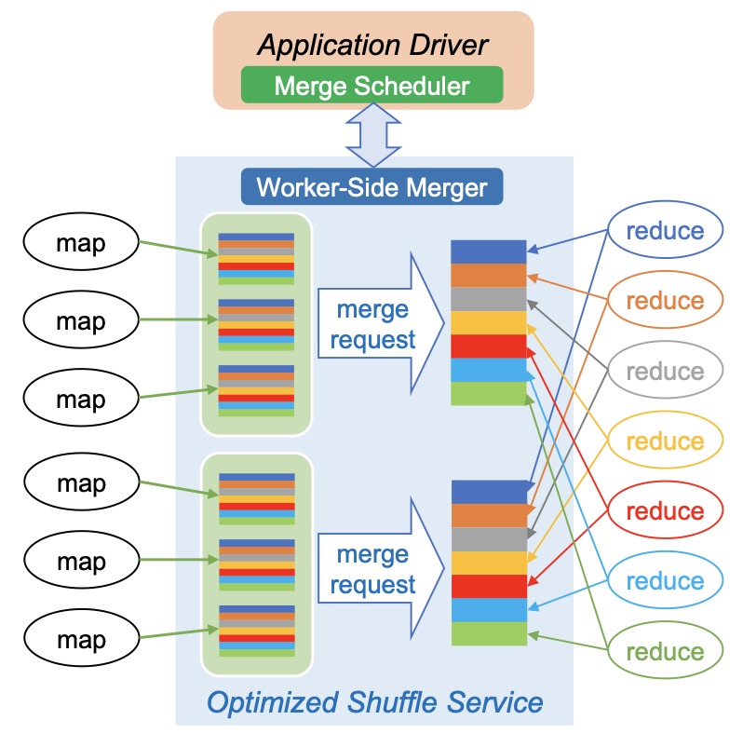
Go back to Riffle paper
Notes:
This is how riffle does a step beyond in the shuffling phase. And how our are going to improve the shuffling performance.
As we mentioned before, if there are 1k mapper and one 1k reducer, even if they only run in small amount of machines, spark will still create 1m temp blocks either in memory or in disks. In order to reduce the data transfer request, a merge function will be called after mappers have done, small files from mappers in same node will be merged into larger files. For each reducer, instead of getting 1k small files, it will request significantly small amount of files.

Slide 13
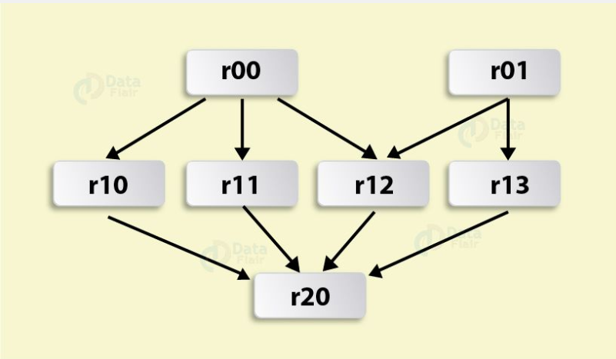
RDD Lineage

Slide 14
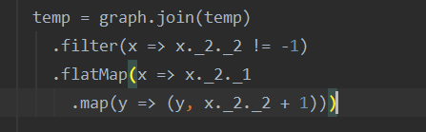
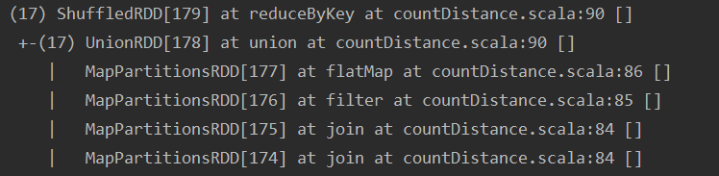
toDebugString()

Slide 15
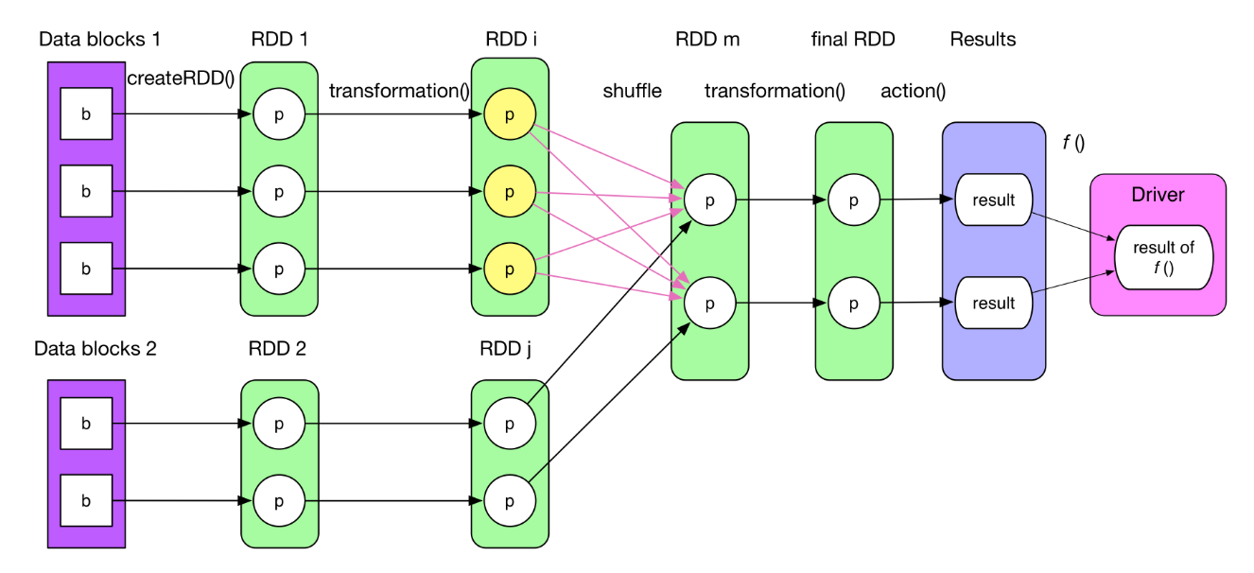
Transformation and action
Notes:
Logical plan is essentially a computing chain. Every RDD has a compute() method which takes the input records of the previous RDD or data source, then performs transformation(), finally outputs computed records.
Jobs are the main function that has to be done and is submitted to Spark. The jobs are divided into stages depending on how they can be separately carried out (mainly on shuffle boundaries). Then, these stages are divided into tasks. Tasks are the smallest unit of work that has to be done the executor.

Slide 16

Demo

Slide 17
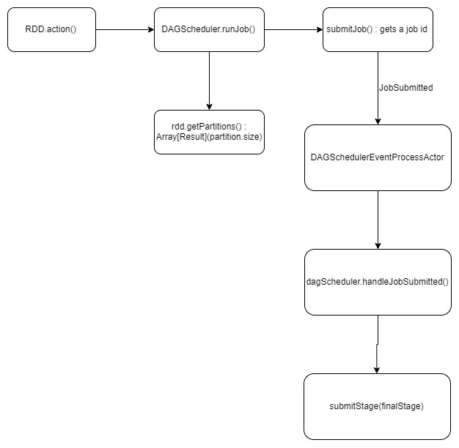

Slide 18
Next Sprint Goals
Design strategies to implement N-Way merge algorithm
Start implementing the N-Way merge algorithm.

Slide 19

Thank You!
Any Questions?

